Slide 1
Title of Topic: FUNCTIONS IN SQL Course Code: 23IT201 Course Title: DataBase Management Systems MODULE –II Academic Year: 2024 - 2025 (Even Sem)
23IT201- DATABASE MANAGEMENT SYSTEMS
MODULE II CONSTRAINTS AND SQL COMMANDS

Slide 2
MAX
23IT201- DATABASE MANAGEMENT SYSTEMS
SELECT MAX(age)
FROM Customers;

Slide 3
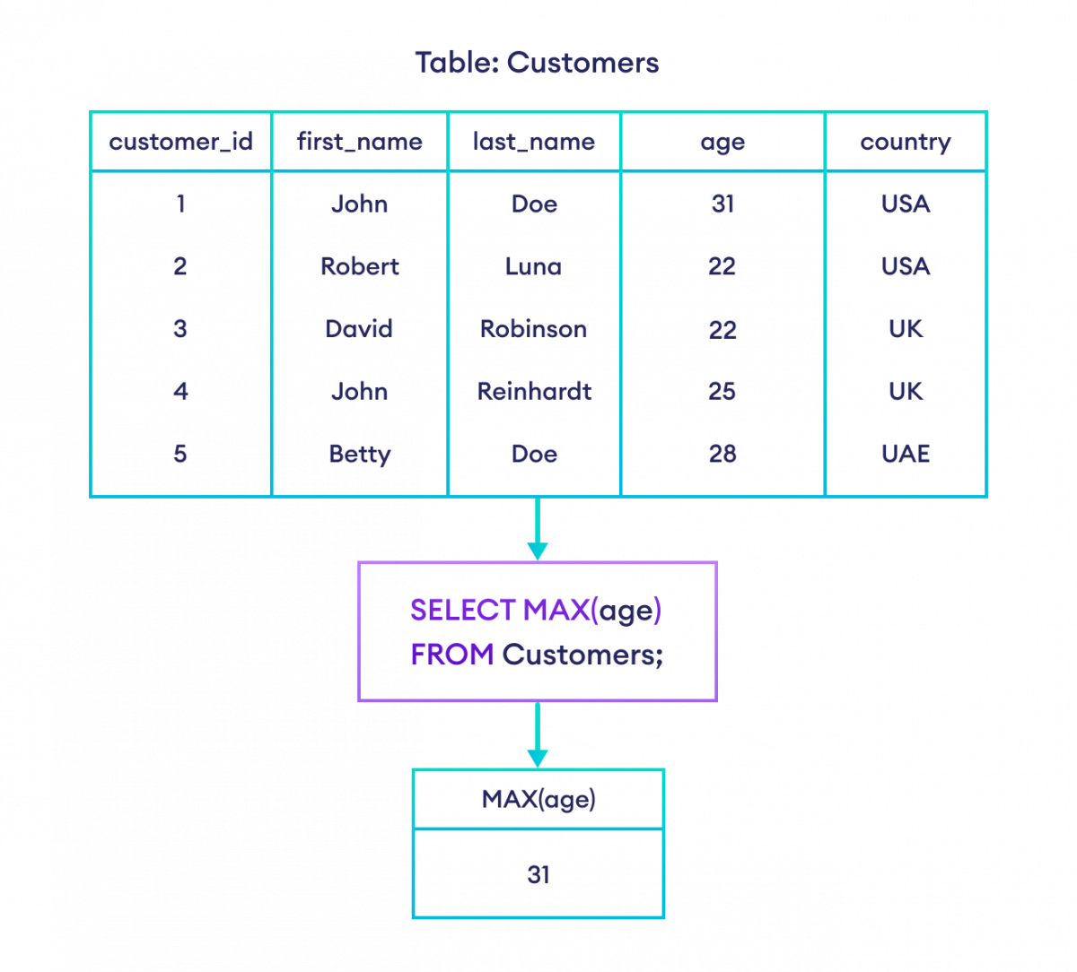
23IT201- DATABASE MANAGEMENT SYSTEMS

Slide 4
MIN
23IT201- DATABASE MANAGEMENT SYSTEMS
SELECT MIN(age)
FROM Customers;

Slide 5
ALIAS NAME
23IT201- DATABASE MANAGEMENT SYSTEMS
SELECT MAX(age) AS max_age
FROM Customers;

Slide 6
MIN IN STRINGS
23IT201- DATABASE MANAGEMENT SYSTEMS
--select the minimum value of first_name from Customers
SELECT MIN(first_name) AS min_first_name
FROM Customers;

Slide 7
MIN() function in a nested SELECT statement
23IT201- DATABASE MANAGEMENT SYSTEMS
SELECT *
FROM Customers
WHERE age = (
SELECT MIN(age)
FROM Customers
);

Slide 8
HAVING CLAUSE
23IT201- DATABASE MANAGEMENT SYSTEMS
SELECT *
FROM Customers
GROUP BY country
HAVING MAX(age);

Slide 9
LIMIT
23IT201- DATABASE MANAGEMENT SYSTEMS
SELECT first_name, age
FROM Customers
LIMIT 2;

Slide 10
LIMIT,OFFSET
23IT201- DATABASE MANAGEMENT SYSTEMS
-- LIMIT 2 selects two results
-- OFFSET 3 excludes the first three results
SELECT first_name, last_name
FROM Customers
LIMIT 2 OFFSET 3;

Slide 11
AVG()
23IT201- DATABASE MANAGEMENT SYSTEMS
--selects the average amount spent by each customer from the Orders table
SELECT customer_id, AVG(amount) AS average_spends
FROM Orders
GROUP BY customer_id;

Slide 12
SUM()
23IT201- DATABASE MANAGEMENT SYSTEMS
--select the sum of the amount of id 4 from orders
SELECT SUM(amount) AS total_of_cus4
FROM Orders
WHERE customer_id = 4;

Slide 13
GROUPBY
23IT201- DATABASE MANAGEMENT SYSTEMS
-- select the item column and the count of order ids from the Orders table
-- group them by the item column
SELECT COUNT(order_id), item
FROM Orders
GROUP BY item;

Slide 14
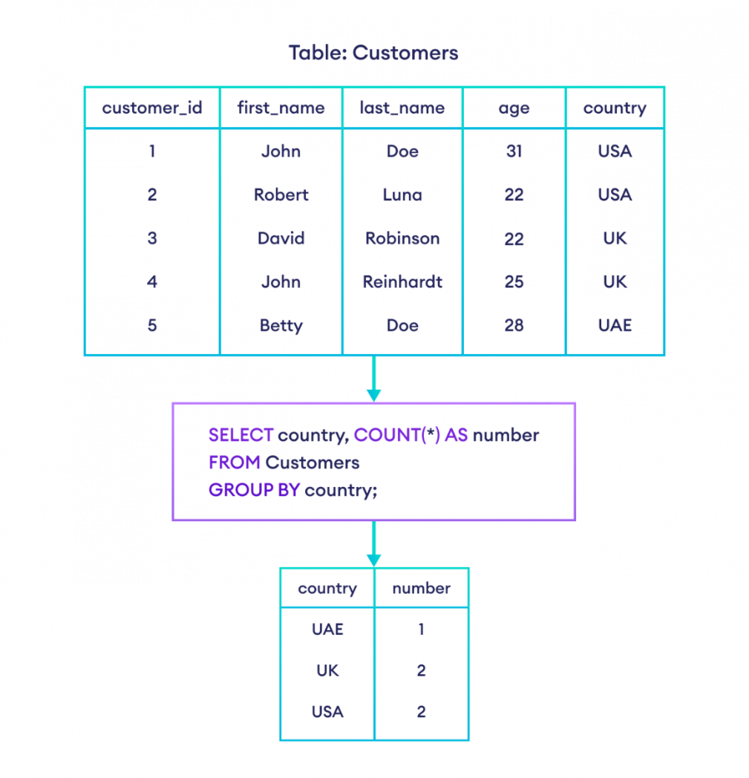
23IT201- DATABASE MANAGEMENT SYSTEMS

Slide 15
HAVING
23IT201- DATABASE MANAGEMENT SYSTEMS
The SQL HAVING clause is used if we need to filter the result set based on aggregate functions such as MIN() and MAX(), SUM() and AVG(), and COUNT().
SELECT AggFunc(column), extra_columns
FROM table
GROUP BY target_column
HAVING condition

Slide 16
HAVING
23IT201- DATABASE MANAGEMENT SYSTEMS
-- select the count of customer ids greater than one and their corresponding country
SELECT COUNT(customer_id), country
FROM Customers
GROUP BY country
HAVING COUNT(customer_id) > 1;

Slide 17
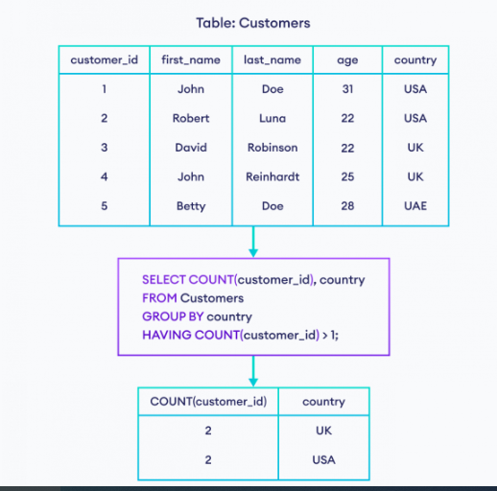

Slide 18
HAVING Vs WHERE CLAUSE
23IT201- DATABASE MANAGEMENT SYSTEMS
HAVING Clause | WHERE Clause
The HAVING clause checks the condition on a group of rows. | The WHERE clause checks the condition on each individual row.
HAVING is used with aggregate functions. | The WHERE clause cannot be used with aggregate functions.
The HAVING clause is executed after the GROUP BY clause. | The WHERE clause is executed before the GROUP BY clause.

Slide 19
ORDERBY
23IT201- DATABASE MANAGEMENT SYSTEMS
-- orders all rows from Customers in ascending order by country
SELECT *
FROM Customers
ORDER BY country;

Slide 20
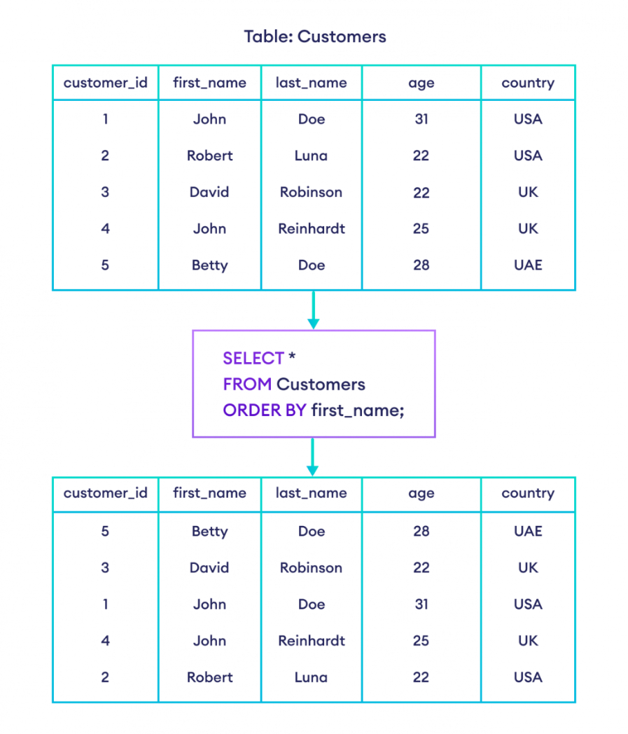

Slide 21
ORDERBY ASC
23IT201- DATABASE MANAGEMENT SYSTEMS
-- orders all rows from Customers in ascending order by age
SELECT *
FROM Customers
ORDER BY age ASC;

Slide 22
ORDERBY DESC
23IT201- DATABASE MANAGEMENT SYSTEMS
-- order all rows from Customers in descending order by age
SELECT *
FROM Customers
ORDER BY age DESC;

Slide 23
DISTINCT
23IT201- DATABASE MANAGEMENT SYSTEMS
-- select the unique countries from the customers table
SELECT DISTINCT country
FROM Customers;

Slide 24
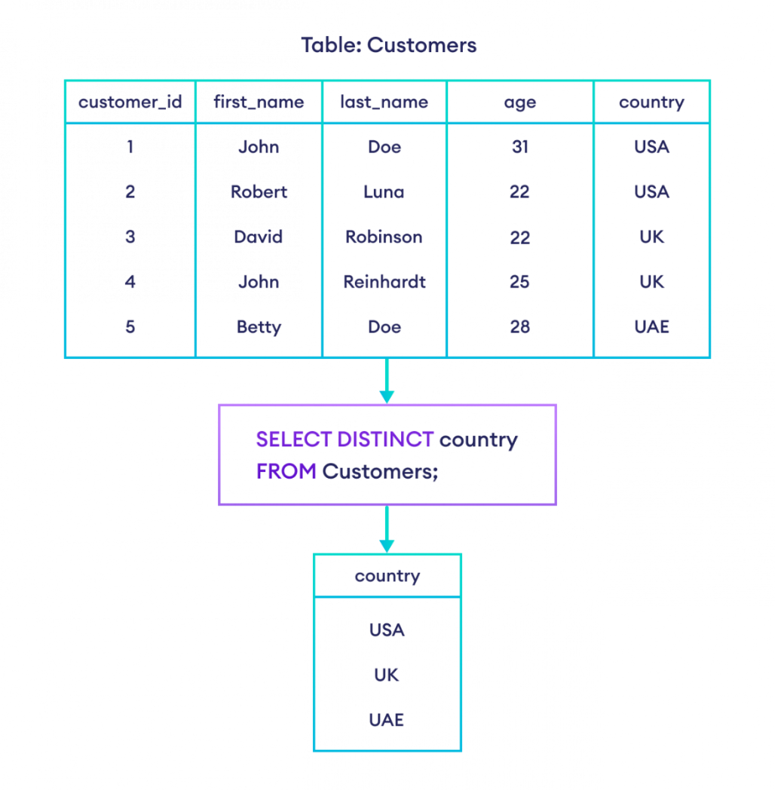

Slide 25
COUNT
23IT201- DATABASE MANAGEMENT SYSTEMS
SELECT COUNT(DISTINCT country)
FROM Customers;

Slide 26
COUNT
23IT201- DATABASE MANAGEMENT SYSTEMS
--returns the number of rows in the Customers table
SELECT COUNT(*)
FROM Customers;

